Slide 1
Database Concepts

Slide 2
Topics Covered
Database Design
Relational Model and its Concepts
DBMS Keys
DBMS Functional Dependency
Data Integrity & integrity rules
ER Diagram
Data Modelling
Codd’s 12 rules for a Relational Database

Slide 3
Database Design
Process through which the databases need to be designed.
The first part of the design is the logical design where need to identify what are the schemas and what are the constraints that apply, what is authorization required.
Physical design which decides on the physical layout of the data, what are the different database files, how they should be indexed and so on.

Slide 4
Relational Model
Collection of relations
A relation is nothing but a table of values.
Every row in the table represents a collection of related data values.
These rows in the table denote a real-world entity or relationship.
The table name and column names are helpful to interpret the meaning of values in each row.
In the relational model, data are stored as tables
However, the physical storage of the data is independent of the way the data are logically organized.

Slide 5
Relational Model Concepts
Attribute: Each column in a Table. Attributes are the properties which define a relation. e.g., Student Rollno, Name, etc.
Tables – In the Relational model the, relations are saved in the table format. It is stored along with its entities. A table has two properties rows and columns. Rows represent records and columns represent attributes.
Tuple – It is nothing but a single row of a table, which contains a single record.
Relation Schema: A relation schema represents the name of the relation with its attributes.
Degree: The total number of attributes which in the relation is called the degree of the relation.
Cardinality: Total number of rows present in the Table.
Relation instance – Relation instance is a finite set of tuples in the RDBMS system. Relation instances never have duplicate tuples.
Relation key - Every row has one, two or multiple attributes, which is called relation key.
Attribute domain – Every attribute has some pre-defined value and scope which is known as attribute domain

Slide 6
DBMS Keys

Slide 7
Relational Integrity constraints

Slide 8
DBMS Functional Dependency

Slide 9
Data Integrity & integrity rules

Slide 10
ER Diagram

Slide 11
Data Modelling
Conceptual: This Data Model defines WHAT the system contains. The purpose is to organize, scope and define business concepts and rules.
Logical: Defines HOW the system should be implemented regardless of the DBMS. The purpose is to developed technical map of rules and data structures.
Physical: This Data Model describes HOW the system will be implemented using a specific DBMS system. The purpose is actual implementation of the database.

Slide 12
Conceptual data model
A conceptual data model identifies the highest-level relationships between the different entities. Features of conceptual data model include:
Includes the important entities and the relationships among them.
No attribute is specified.
No primary key is specified.

Slide 13
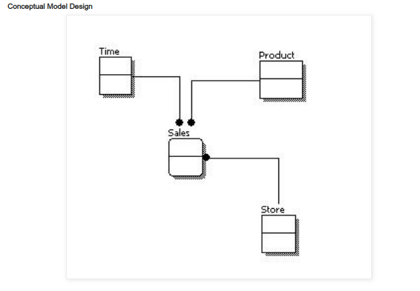
Conceptual Model Design

Slide 14
Logical data model
A logical data model describes the data in as much detail as possible, without regard to how they will be physical implemented in the database. Features of a logical data model include:
Includes all entities and relationships among them.
All attributes for each entity are specified.
The primary key for each entity is specified.
Foreign keys (keys identifying the relationship between different entities) are specified.
Normalization occurs at this level.

Slide 15
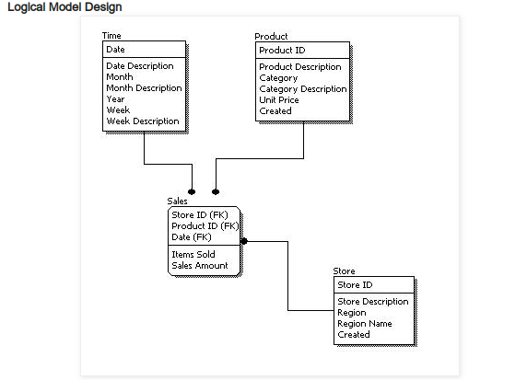
Logical Model Design

Slide 16
Physical data model
Physical data model represents how the model will be built in the database.
Physical data model include:
Specification all tables and columns.
Foreign keys are used to identify relationships between tables.
Physical considerations may cause the physical data model to be quite different from the logical data model.
Physical data model will be different for different RDBMS. For example, data type for a column may be different between Oracle, DB2 etc.

Slide 17
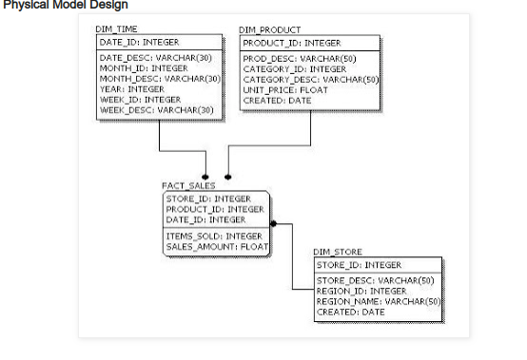
Physical Model Design

Slide 18
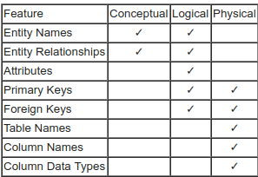
Data modelling

Slide 19
Codd’s 12 rules for a Relational Database
Dr Edgar F. Codd, after his extensive research on the Relational Model of database systems, came up with twelve rules of his own, which according to him, a database must obey in order to be regarded as a true relational database.
These rules can be applied on any database system that manages stored data using only its relational capabilities.
This is a foundation rule, which acts as a base for all the other rules

Slide 20
Codd’s 12 rules for a Relational Database
Rule 1
Information Rule
The data stored in a database, may it be user data or metadata, must be a value of some table cell. Everything in a database must be stored in a table format
Rule 2
Guaranteed Access Rule
Every single data element is guaranteed to be accessible logically with a combination of table-name, primary-key (row value), and No other means, such as pointers, can be used to access data
Rule 3
Systematic Treatment of NULL Values
The NULL values in a database must be given a systematic and uniform treatment. This is a very important rule because a NULL can be interpreted as one the following − data is missing, data is not known, or data is not applicable
Rule 4
Active Online Catalog
The structure description of the entire database must be stored in an online catalog, known as data dictionary, which can be accessed by authorized users. Users can use the same query language to access the catalog which they use to access the database itself

Slide 21
Codd’s 12 rules for a Relational Database
Rule 5
Comprehensive Data Sub-Language Rule
A database can only be accessed using a language having linear syntax that supports data definition, data manipulation, and transaction management operations. This language can be used directly or by means of some application.
Rule 6
View Updating Rule
All the views of a database, which can theoretically be updated, must also be updatable by the system
Rule 7
High-Level Insert, Update, and Delete Rule
A database must support high-level insertion, updation, and deletion. This must not be limited to a single row, that is, it must also support union, intersection and minus operations to yield sets of data records
Rule 8
Physical Data Independence
The data stored in a database must be independent of the applications that access the database. Any change in the physical structure of a database must not have any impact on how the data is being accessed by external applications.

Slide 22
Codd’s 12 rules for a Relational Database
Rule 9
Logical Data Independence
The logical data in a database must be independent of its user’s view. Any change in logical data must not affect the applications using it. For example, if two tables are merged or one is split into two different tables, there should be no impact or change on the user application.
Rule 10
Integrity Independence
A database must be independent of the application that uses it. All its integrity constraints can be independently modified without the need of any change in the application.
Rule 11
Distribution Independence
The end-user must not be able to see that the data is distributed over various locations. Users should always get the impression that the data is located at one site only. This rule has been regarded as the foundation of distributed database systems.
Rule 12
Non-Subversion Rule
If a system has an interface that provides access to low-level records, then the interface must not be able to subvert the system and bypass security and integrity constraints.

